Slide 1
Chapter 11
Memory, Learning and Amnesia

Slide 2
Atkinson-Shiffrin memory model
Three stages of memory storage
Sensory register – .5-1 seconds
Short-term store – 10-15 seconds
Long-term store – relatively permanent
Interference
Memory attributes – external stimuli
Retrieval to short-term store for processing

Slide 3
Processes in memory
There are three major phases in forming and retrieving memory from long-term memory:
Encoding (obtaining and processing information)
Storage (producing a record of the encodedinformation)
Retrieval, recall or recollection (retrieving the information that has been stored)

Slide 4
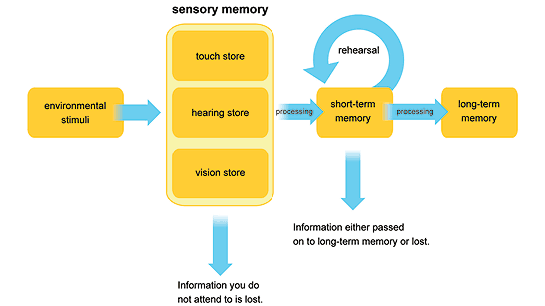
Sensory memory
Corresponds to about the first 200-500 milliseconds after the perception of an item
The definition of sensory memory is in truth numerous sensory memory systems, one associated with each sense
Sensory memory for vision, called iconic memory

Slide 5
Short-term memory
Short-term memory makes it possible to remember a small amount of information in an active state for a short period of time
Chunking

Slide 6
Working memory
Temporary storage and manipulation of the information
Central executive – controller
Visuospatial sketch pad – visual information
Phonological loop – auditory information
Episodic buffer – linking information

Slide 7
Neural substrate of working memory
Phonological loop occurs in the left hemisphere, where storage occurs in a part of the temporoparietal junction (Brodmann area 40) and rehearsal is more associated with the anterior Brodmann area (44), which has long been associated with production of speech (Paulesu, Frith, & Frackowiak, 1993)
Visuo-spatial sketchpad involves right hemisphere areas, one visual, most likely a reflection of the processing and retention of items and their visual features. A second area is more parietal, most likely involving spatial aspects, while two frontal areas of activation have been connected with control functions (Fletcher & Henson, 2001)
Central executive involves the frontal lobes, despite the fact that there are differing opinions as to the extent to which different executive functions can be individually localizable (Duncan & Owen, 2000)
We have not seen much evidence regarding the localization of the episodic buffer, which appears apt to reflect a widely distributed system that may not trigger activation in any particular area (Baddeley, 2000)

Slide 8
Long-term memory
Two broad classifications, declarative and non-declarative or implcit
Declarative memory system is conscious and it includes memories of facts and occurrences
Non-declarative memory, also known as implicit or procedural memory, is the memories for skills and habits

Slide 9
Types of learning
Associative learning involves a connection between two elements or events
Classical conditioning
Operant conditioning
Non-associative learning involves change in the magnitude of response to environmental events
Habituation
Sensitization

Slide 10
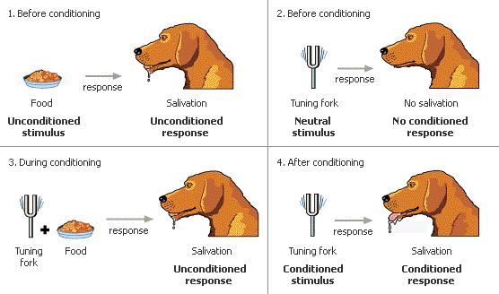
Classic conditioning
Classic conditioning is sometimes referred to as Pavlovian conditioning
UCR – drool in response to food (not learned)
UCS – food (triggers drool reflex)
CR – drool in response to sound of bell (learned)
CS – sound of bell (triggers drool reflex)

Slide 11
Instrumental or operant conditioning
Unlike classical conditioning, operant conditioning involves altering ‘voluntary behaviour’ or operant behaviour
Skinner developed the concept of operant conditioning
Extinction is the lack of any consequence following a behaviour
Shaping
Guiding current behaviour towards some desired behaviour through successive approximations

Slide 12
Instrumental or operant conditioning
Reinforcers can be one of two types:
Positive reinforcers – positive outcomes follow the behaviour
Negative reinforcers – taking away unfavourable things after a behaviour and so, in this case, a reaction is made stronger by taking away something that is disliked or seen as unpleasant
Two types of punishment exist:
Positive punishment – consists of giving an unfavourable element such as to weaken the subsequent response
Negative punishment – a favourable event or outcome is taken away following a specific behaviour

Slide 13
Neural mechanisms of reinforcement
Medial forebrain bundle (MFB) from the midbrain to the anterior basal forebrain passing through the lateral hypothalamus
Electrical stimulation in regions of the lateral hypothalamic area are positively reinforcing and induces eating in satiated animals
The mesolimbic dopamine pathway plays a major role in reinforcement

Slide 14
Hebbian theory
Donald Hebb's theory (1949)
If one neuron’s activity or firing repeatedly contributes to the firing of another cell, the size of this contribution will tend to increase gradually with time
Cell assemblies are the most basic unit of memory
Theory can explain short-term memory
May not account for long-term memory

Slide 15
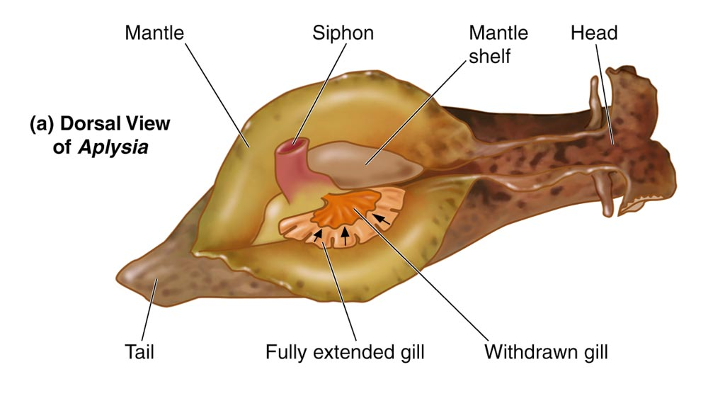
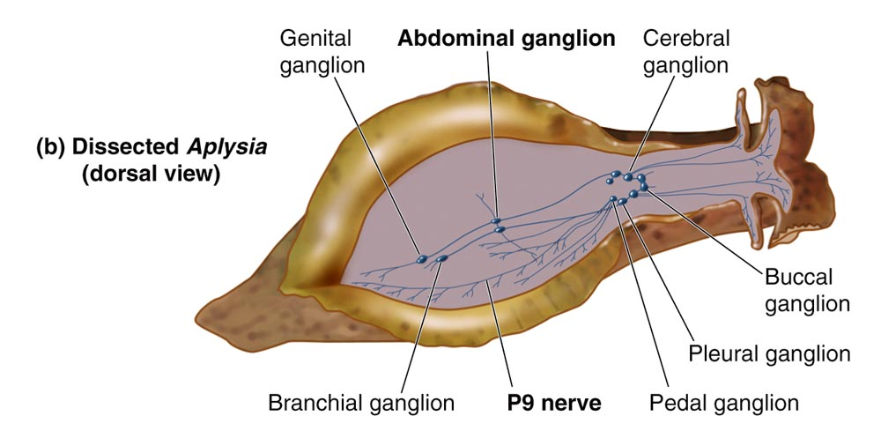
Aplysia californica
The gill is used for breathing
The gill is covered with the mantle shelf
Waste and seawater are released through the siphon
The gill-withdrawal reflex produced by touching the siphon, which leads to a retraction of the gill

Slide 16
Nonassociative learning
Habituation
The response to steady or repeated (harmless) stimulus decreases over time
Sensitization
The experience of one stimulus heightens the response to a subsequent stimulus
Notes:
Habituation
The response to steady or repeated (harmless) stimulus decreases over time.
Example: You don’t hear your air conditioner after it’s been running awhile, or sounds of night insects
Sensitization
The experience of one stimulus heightens the response to a subsequent stimulus.
Presumably harmful
Example: People are ‘jumpy’ following natural disasters, like earthquakes.
Difference is:
1. Intensity of stimulus: usually low intensity, habit; high, sens
2. whether or not we have deemed the stimuli to be dangerous or not

Slide 17
Aplysia californica
The siphon is served by 24 sensory neurons (touch receptors), cell bodies are in the abdominal ganglion
Ganglia collect sensory information
Siphon sensory neurons form synapses with:
1. Excitatory and inhibitory interneurons
2. Six motor neurons serving the gill
So if siphon is touched, it sends signals via the sensory neurons in the abdominal ganglion to motor neurons in the gill, telling it to retract – gill withdrawal reflex
Now, if siphon is touched repeatedly, this gill-withdrawal reflex gets weaker, i.e. the gill does not withdraw as much – habituation

Slide 18
Aplysia californica
Sensitization: this is a little bit more complicated
Sensitization needs a stimulus that can be perceived as harmful
Process – shock tail at the same time as we touch siphon
Sensory neuron in the tail, which sends input to an interneuron
This interneuron sends input to sensory neuron to the gill neurons, and the gill retracts strongly

Slide 19
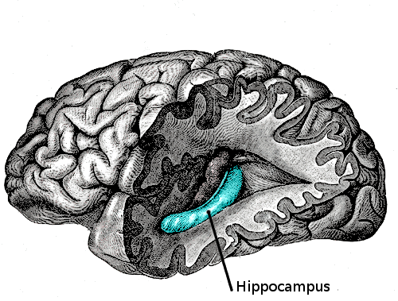
Brain areas involved in memory: the hippocampus
The hippocampus is a component of the limbic system
Extensive hippocampal damage may experience the inability to form or retain new memories; this is generally called anterograde amnesia and
Can affect memories created before injury termed retrograde amnesia
Place cells
Plasticity of brain – LTP

Slide 20
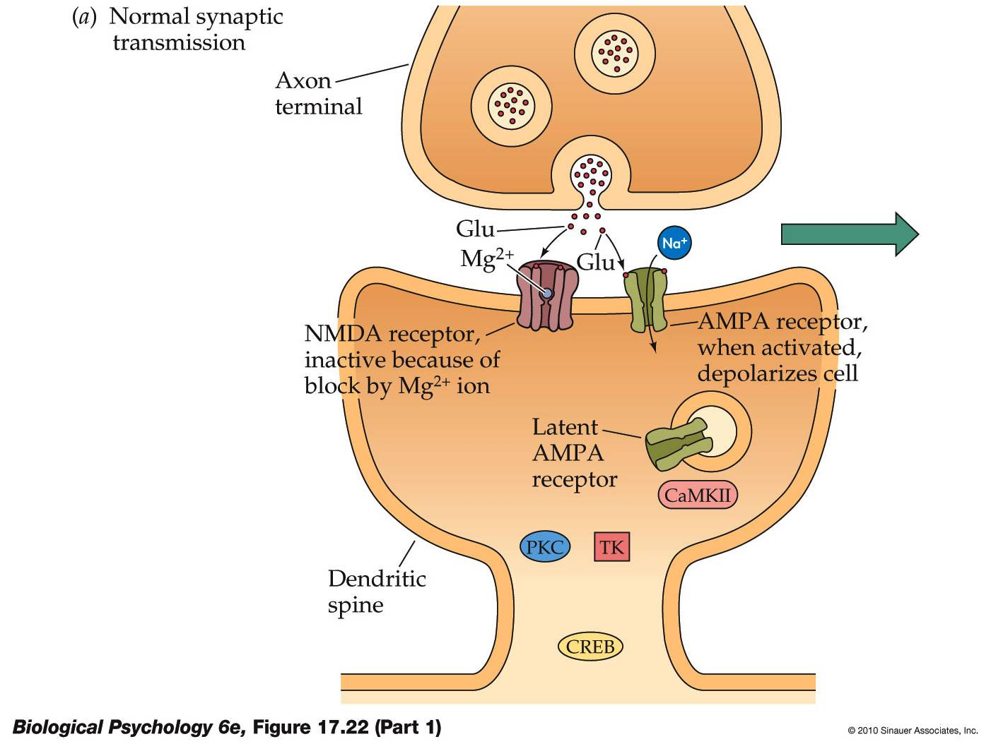
The cellular basis of memory: long-term potentiation
NMDA receptors at rest have magnesium ion (Mg2+) block on their calcium (Ca2+) channels
After partial depolarization, the block is removed and the NMDA receptor allows Ca2+ to enter in response to glutamate

Slide 21
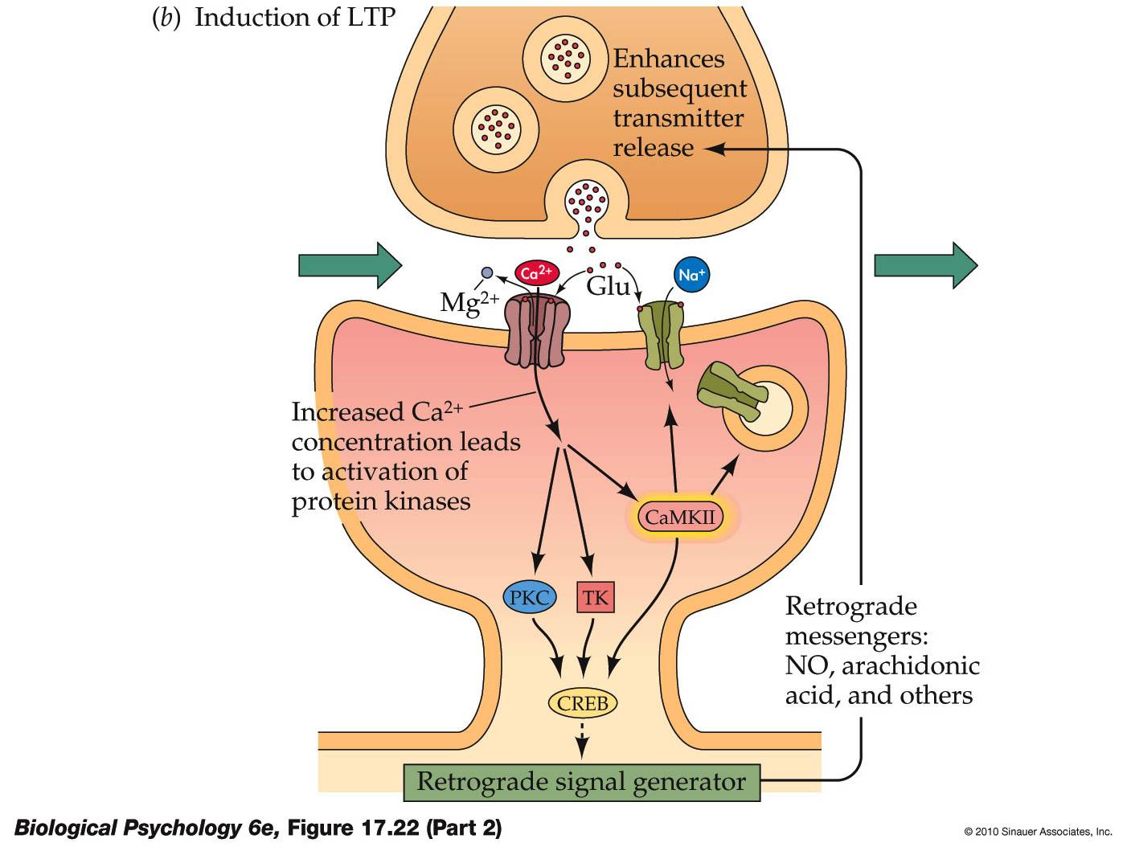
The cellular basis of memory: long-term potentiation
The Ca1 region has both NMDA and AMPA receptors
Glutamate first activates AMPA receptors
NMDA receptors do not respond until enough AMPA receptors are stimulated and the neuron is partially depolarized

Slide 22
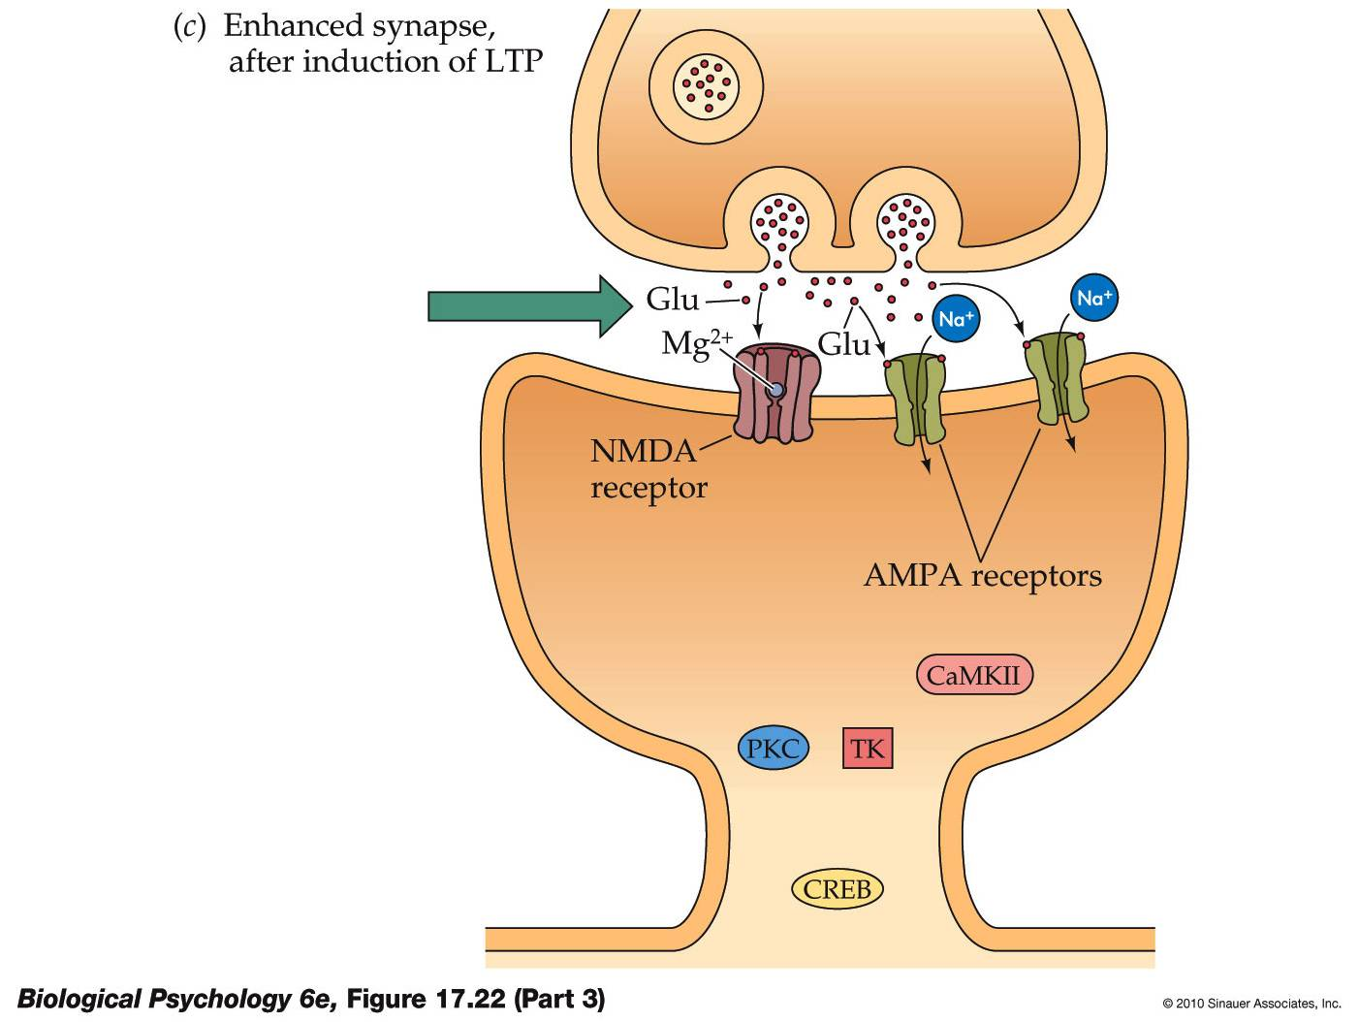
The cellular basis of memory: long-term potentiation
NMDA receptors at rest have a magnesium ion (Mg2+) block on their calcium (Ca2+) channels
After partial depolarization, the block is removed and the NMDA receptor allows Ca2+ to enter in response to glutamate

Slide 23
The cellular basis of memory: long-term potentiation
The large Ca2+ influx activates protein kinases – enzymes that add phosphate groups to protein molecules
One protein kinase is CaMKII – it affects AMPA receptors in several ways:
Causes more AMPA receptors to be produced and inserted in the postsynaptic membrane
Moves existing nearby AMPA receptors into the active synapse
Increases conductance of Na⁺ and K⁺ ions in membrane-bound receptors
All increase the synaptic sensitivity to glutamate

Slide 24
Cerebellum and long-term depression
Long-term depression (LTD) is a process to weaken specific synapses
Cerebellar LTD to be important for motor learning
Happens when the climbing fibres and parallel fibres are activated at the same time
Postsynaptic – Purkinje cell
Glutamate released from the parallel fibre terminals triggers the AMPA-type of receptor and the glutamate receptors and the activation of the glutamate receptor initiates a second messenger cascade
Activation of the climbing fibres causes a large influx of Ca2+ through voltage-gated channels and an increase in intracellular Ca2+ concentration
The simultaneous activation of these two intracellular pathways leads to LTD

Slide 25
Amygdala
Perform principal roles in forming and storing memories associated with emotional events
Conditioned fear responses in rats
Responsible for pleasurable emotional learning (Herbert et al., 2009)

Slide 26
Motor memory and the basal ganglia
Traditionally regulate the initiation of movements
Unconscious memory processes like motor skills, locomotion and implicit memory (Wilkinson et al., 2009)
Damage to basal ganglia – the individual has difficulty learning motor & perceptual-motor skills (Boyd & Winstein, 2004)

Slide 27
Frontal lobe
Coordination of information and working memory
Lateral prefrontal cortex has been linked to the encoding and retrieval of episodic memory (Lee et al., 2000)
Play a role in prospective memory (Basso et al., 2010)

Slide 28
Temporal lobe
Plays a role in recognition memory (Squire et al., 2007)
Damage to the temporal lobes leads to a range of disturbances, including attention and perceptual disturbances, and problems with organization and language comprehension

Slide 29
Parietal lobe
Individuals with parietal lobe damage exhibit both working memory and long-term memory deficits (Olson & Berryhill, 2009)
May play a role in the storage of retrieved information in a working memory buffer for further cognitive processing (Haramati et al., 2008)

Slide 30
Occipital lobe
Dorsal pathway projects to the parietal lobe and is associated with representation of object locations
Ventral pathway projects to the temporal lobe and is associated with form recognition and object representation

Slide 31
Amnesia
Amnesia can either be neurological or functional in nature and can be divided into four types:
Anterograde amnesia, which is an impairment in storing new memories
Retrograde amnesia, which is a loss of old memories, and
Psychogenic or functional amnesia, which involves a functional loss of memories
Temporary amnesia can also result following the use of certain drugs, such as benzodiazepines and anticholinergics

Slide 32
Anterograde amnesia
Severe impairment in learning new information
Damage to the hippocampus and associated areas in the medial temporal lobes
Korsakoff's syndrome is a good example of this type of amnesia

Slide 33
Retrograde amnesia
Impairment of the memories that were obtained prior to the onset of amnesia
Patients can still recall the facts and events of their childhood and teenage years (Kirwan et al., 2008)

Slide 34
Psychogenic or functional amnesia
Psychogenic amnesia can happen as an outcome of an emotional trauma
Symptoms associated with this type of amnesia are different from those of anterograde and retrograde memory loss

Slide 35
Case study 1: Clive Wearing
One of the most severe documented cases of amnesia
Infected at the age of 46 with the herpes simplex virus which destroyed his hippocampus and left him profoundly amnesic
He recognizes his wife and family, retains a normal vocabulary and can still play the piano

Slide 36
Case study 2: Henry Gustav Molaison (H.M.)
Patient H.M. suffers from amnesia or memory impairment
Retrograde amnesia is the loss of memories formed before onset of amnesia
Anterograde amnesia is the inability to form memories after onset of a disorder

Slide 37
Case study 2: Henry Gustav Molaison (H.M.)
Damage to the hippocampus can produce memory deficits
H.M.’s surgery removed the amygdala, the hippocampus and some cortex
H.M.’s memory deficit was confined to verbal tasks

Slide 38
Case study 2: Henry Gustav Molaison (H.M.)
Procedural memory intact

Slide 39
Memory

Slide 40
Conditioning

Slide 41
Neural areas & memory

Slide 42
Amnesia

Slide 43
Memory

Slide 44
Readings
Barnes, J. (2011). Essential Biological Psychology (Chapter 11). London: Sage.
The Essentials
Baddeley, A.D. (1999). Essentials of Human Memory. Hove, East Sussex: Psychology Press.
Next Steps
Bird, C.M., & Burgess, N. (2008). The hippocampus and memory: insights from spatial processing. [Review]. Nature Reviews Neuroscience, 9(3), 182-194.
Delving Deeper
Squire, L.R., Wixted, J.T., & Clark, R.E. (2007). Recognition memory and the medial temporal lobe: a new perspective. Nature Reviews Neuroscience, 8(11), 872-883.

